Slide 1

INTERIM FINANCIAL REPORT
Tencent Holdings
Limited
2025 Interim Report
Three and Six Months Ended 30 June 2025
August 2025
HKEX: 0700

Slide 2
PRESENTATION OVERVIEW
Contents
01
02
03
Executive Summary
Financial Performance
Revenue by Segment
Key performance highlights and strategic achievements
Q2 and H1 2025 results with YoY comparisons
Breakdown across VAS, Marketing, and FinTech
04
05
06
Profitability & Margins
Games Performance
AI Integration
Gross margin expansion and cost efficiency
Domestic and international games growth
Technology innovation across all platforms
07
08
09
User Metrics
Investment Portfolio
Strategic Outlook
Platform engagement and subscriber data
Financial position and liquidity analysis
Future priorities and growth initiatives

Slide 3
PERFORMANCE OVERVIEW
Executive Summary
Strong Double-Digit Growth
Chairman's Statement
Delivered robust performance in Q2 and H1 2025 with 15% YoY revenue growth and 17% profit increase in Q2, driven by strategic AI investments and operational excellence across all business segments.
"During the second quarter of 2025, we delivered double-digit revenue and non-IFRS operating profit growth on a year-on-year basis, as we invested in, and also benefitted from, utilising AI."
Games Leadership
Domestic games revenue grew 17% YoY with Delta Force achieving 20M+ DAU and ranking top 3 industry-wide. International games surged 35% YoY driven by Supercell and PUBG MOBILE.
— Ma Huateng, Chairman & CEO
AI-Powered Marketing
WeChat MAU
Gross Margin
Marketing Services revenue increased 20% YoY through AI-driven advertising platform upgrades, enhancing click-through rates and advertiser ROI across Video Accounts, Mini Programs, and Weixin Search.
1.41B
57%
+3% YoY
+4pp YoY
Notes:
Emphasis: 15% revenue growth demonstrates continued monetization strength. WeChat MAU milestone of 1.41 billion users.

Slide 4
FINANCIAL PERFORMANCE
Q2 2025 Highlights
Three months ended 30 June 2025
Revenues
+15%
Gross Profit
+22%
Quarter-on-Quarter Performance
184.5B
105.0B
Revenues
+2%
RMB million
RMB million
RMB 184.5B
vs Q1 2025: RMB 180.0B
Operating Profit
+18%
Profit Attributable
+17%
60.1B
55.6B
Gross Profit
+4%
RMB 105.0B
RMB million
RMB million
vs Q1 2025: RMB 100.5B
Earnings Per Share
Operating Profit
+4%
RMB 60.1B
Basic EPS
Diluted EPS
vs Q1 2025: RMB 57.6B
RMB 6.115
RMB 5.996
+20% YoY
+20% YoY
Profit Attributable
+16%
RMB 55.6B
Non-IFRS Profit Attributable
vs Q1 2025: RMB 47.8B
RMB 63.1B
+10% YoY

Slide 5
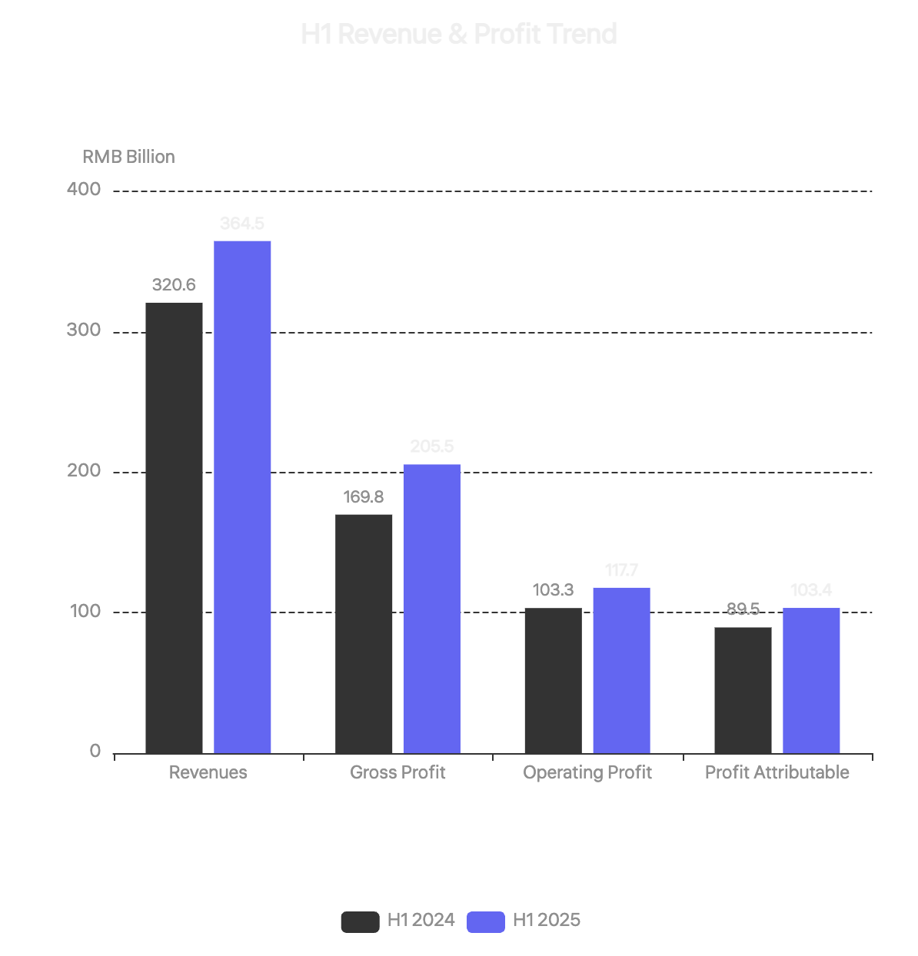
FIRST HALF 2025
H1 2025 Consolidated Results
Six months ended 30 June 2025
Total Revenues
Gross Profit
364.5B
205.5B
+14%
YoY
+21%
YoY
RMB million
RMB million
Operating Profit
117.7B
+14%
YoY
RMB million
Profit Attributable
103.4B
+16%
YoY
RMB million
H1 2025 EPS Performance
Basic EPS
Diluted EPS
RMB 11.367
RMB 11.126
+19% YoY
+19% YoY

Slide 6
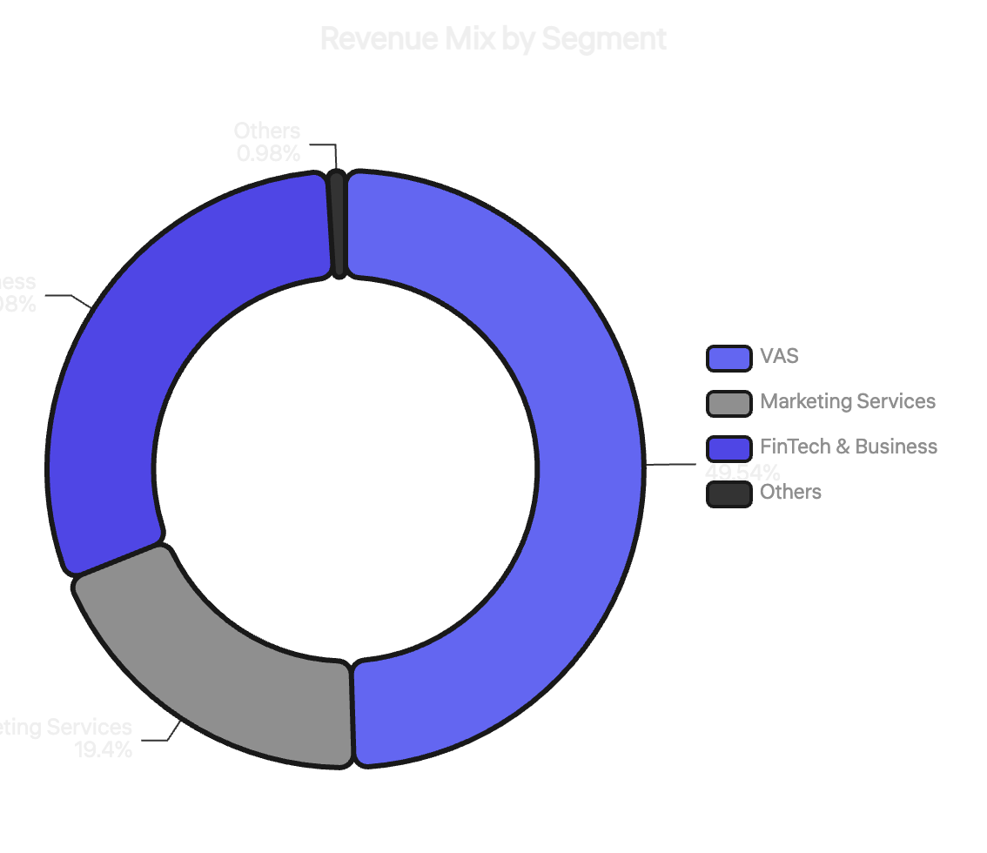
BUSINESS SEGMENTS
Revenue Analysis by Segment
Q2 2025 segment performance
Value-Added Services
50%
RMB 91.4B
+16% YoY
Games + Social Networks
Domestic Games
International Games
RMB 40.4B
RMB 18.8B
+17% YoY
+35% YoY
Marketing Services
19%
RMB 35.8B
+20% YoY
AI-powered advertising platform
FinTech & Business Services
30%
RMB 55.5B
+10% YoY
Payment + Cloud + AI services

Slide 7
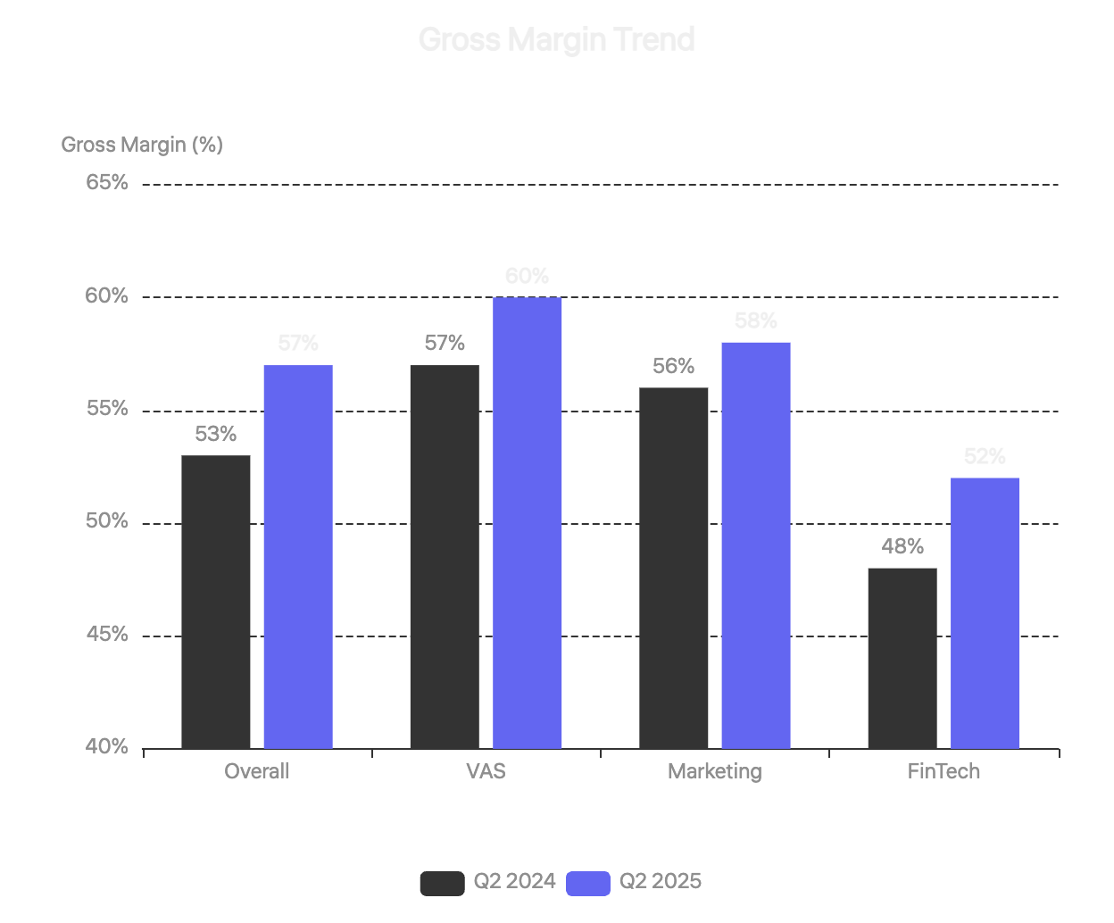
MARGIN EXPANSION
Profitability & Margins
Gross margin improvement driven by high-margin revenue streams
Overall Gross Margin
57%
+4pp
vs 53% in Q2 2024
Driven by increased contributions from high-margin revenue streams including Domestic Games, Video Accounts, and Weixin Search, alongside enhanced cost efficiency.
Segment Gross Margins (Q2 2025)
VAS
60%
vs 57% in Q2 2024
Marketing Services
58%
vs 56% in Q2 2024
FinTech & Business
52%
vs 48% in Q2 2024

Slide 8
GAMING BUSINESS
Games Performance
Domestic and international games driving VAS growth
Domestic Games
International Games
China market
Global markets
Revenue
Revenue
RMB 40.4B
+17% YoY
RMB 18.8B
+35% YoY
+33% on constant currency basis
Delta Force
First-person shooter released Sep 2024
Key Growth Drivers
20M+
Top 5
Top 3
Supercell games performance
Monthly DAU
Industry DAU Rank
Gross Receipts Rank
PUBG MOBILE growth
Dune: Awakening contribution
Evergreen Titles
Honor of Kings
Peacekeeper Elite
VALORANT
Clash Royale Highlights
More frequent content updates, optimized reward system, and community events boosted DAU to a 7-year high in June 2025.
Total Games Revenue
Mini Games Gross Receipts
AI in Games
RMB 59.2B
+20%
Deployed
+22% YoY
YoY Growth
Content & NPCs

Slide 9

TECHNOLOGY INNOVATION
AI Integration & Innovation
AI driving value creation across all platforms and services
Weixin AI Features
Game AI Tools
AI-Powered Citations
Content Production
Intelligent content citations and references in Weixin content
AI tools accelerating game content creation pipeline
Mini Shops Intelligence
Virtual Teammates & NPCs
Automated responses to customer enquiries for merchants
Realistic AI-powered characters enhancing gameplay
Video Summaries
AI Marketing
Automated text summaries for Video Accounts clips
User acquisition and engagement campaigns
Advertising Platform
HunYuan Models
AI Foundation Model Upgrade
HunYuan 3D Model - Ranked #1
Enhanced advertising performance across Video Accounts, Mini Programs, and Weixin Search
Leading Hugging Face leaderboard for geometric precision, texture fidelity, and prompt-3D alignment
+20%
Higher
Marketing Services Revenue
CTR & Conversions
Adoption Growing
Game developers, 3D printing enterprises, and design professionals increasingly adopting HunYuan 3D

Slide 10
PLATFORM ENGAGEMENT
User Metrics & Engagement
Strong user base across social platforms and content services
Weixin & WeChat
Content Services Subscribers
Combined MAU
1.411B
Tencent Video
114M
+3% YoY
Leading position in China's long-form video market
Sustained leadership in China's social messaging market
Average daily paying users in Q2 2025
Tencent Music
124M
QQ Mobile
Mobile device MAU
Leading music streaming platform in China
Average paying users at quarter-end
532M
-7% YoY
Strategic focus shift to younger demographics
Mini Games Performance
Fee-based VAS
Gross Receipts Growth
Paying users
+20%
264M
Year-on-year in Q2 2025
+0.4% YoY
Expanded game engine compatibility
Stable premium subscriber base
Enhanced graphics rendering
Reduced load time

Slide 11
FINANCIAL POSITION
Investment Portfolio & Liquidity
Strong financial foundation supporting strategic growth initiatives
Investment Portfolio (as of 30 June 2025)
Major Investment: Sea Limited
Total Portfolio Value
Listed Investee Companies
Sea Limited (NYSE: SE)
RMB 948.3B
RMB 714.3B
eCommerce, Digital Financial Services, Digital Entertainment
vs RMB 817.7B in Dec 2024
Fair value of shareholdings
Shareholding
~17.6% (104M shares)
Carrying Value
RMB 119.4B
Unlisted Investee Companies
H1 2025 Return
Total Cost
RMB 1.7B
RMB 342.3B
RMB 10.6B
% of Total Assets
~5.9%
Carrying book value
+28% vs H1 2024
H1 2025 Unrealized Gains
RMB 40.3B
Cash Flow & Liquidity
Included in other reserves under equity
Net Cash Position
RMB 74.6B
Key Financial Ratios
As of 30 June 2025 (vs RMB 90.2B in Q1 2025)
Decrease due to FY2024 final dividend payment of RMB 37.5B
Total Debts / Adj. EBITDA
Adj. EBITDA Margin
1.29x
46%
Q2 Free Cash Flow
RMB 43.0B
Operating cash flow RMB 74.4B offset by capex
H1 Capital Expenditures
RMB 46.6B
vs RMB 23.1B in H1 2024
Primarily for AI infrastructure and data centers

Slide 12

LOOKING AHEAD
Strategic Outlook
Continued innovation and AI-driven growth
AI Leadership
Games Excellence
Our Commitment
Continue investing in AI capabilities across all business lines, upgrading HunYuan foundation models, and expanding AI use cases within Weixin ecosystem.
Maintain leadership in domestic and international markets through evergreen title evolution, new game launches, and AI-enhanced gaming experiences.
"Value for User, Tech for Good"
We remain committed to our core principle and continue to deliver meaningful impact through technology.
Drive innovation
Advertising Growth
Cloud & FinTech
Adapt to evolving community needs
Leverage AI-powered advertising platform to drive higher ROI for advertisers and capture growing demand across Video Accounts and Mini Programs.
Expand enterprise AI-related services including GPU rental and API token usage, while growing commercial payment volume and wealth management services.
Contribute to inclusive, sustainable future
Yuanbao & AI Native Apps
Thank you for your trust and support
Drive adoption of AI native app Yuanbao and bring further benefits of AI to consumers and enterprises through powering more use cases within Weixin and beyond.
Tencent Holdings Limited
HKEX: 0700 | www.tencent.com

